Slide 1
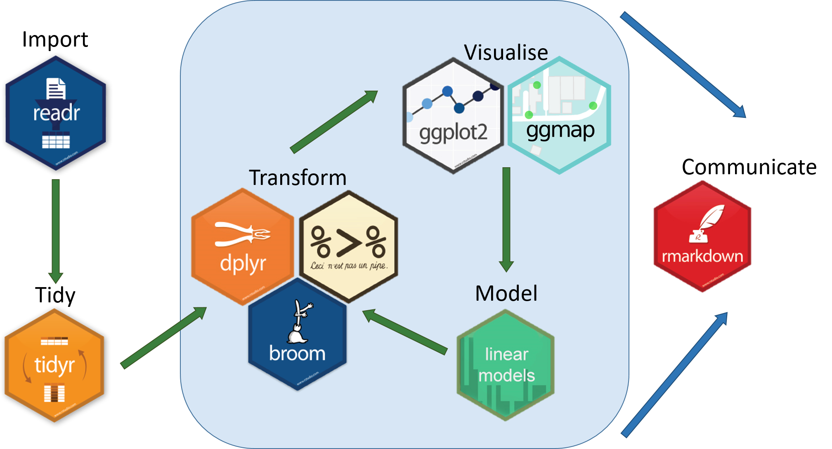


Slide 2
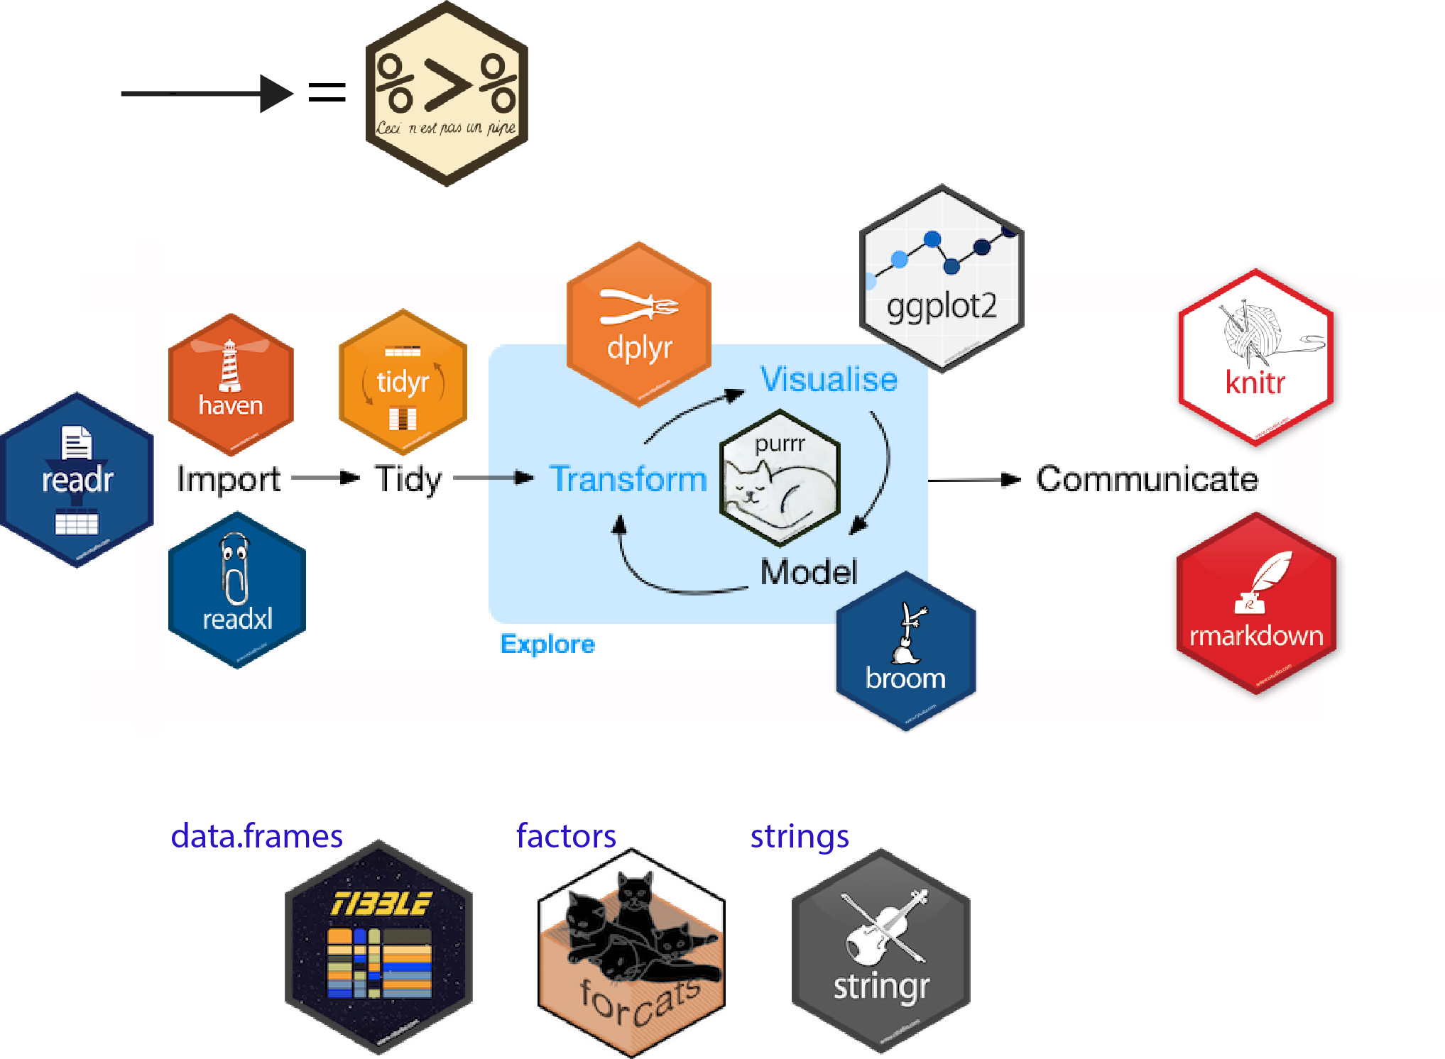


Slide 3

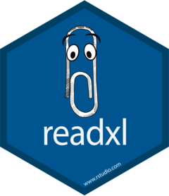





Slide 4

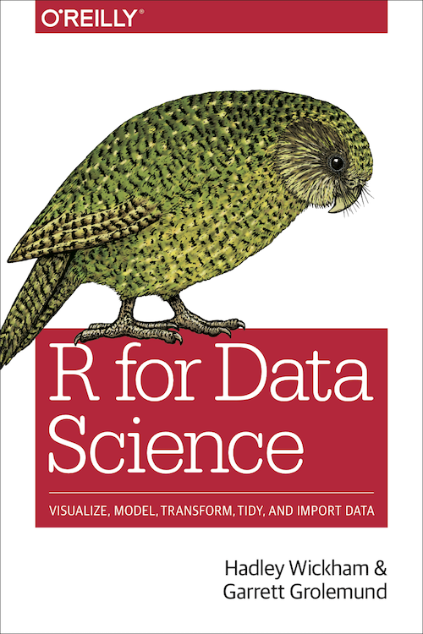


Slide 5
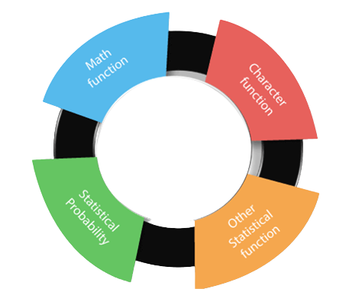

Slide 6


Slide 7

Free and Open-source Tool
Gateway to lucrative career
1
5
Large Community of
Users (#rstats)
Has a robust
visualization
2
6
Why Learn R
Can Interact with Databases
3
Go to language for statistics and
data science
7
Cross-platform Support
Used in almost every industry
4
8

Slide 8
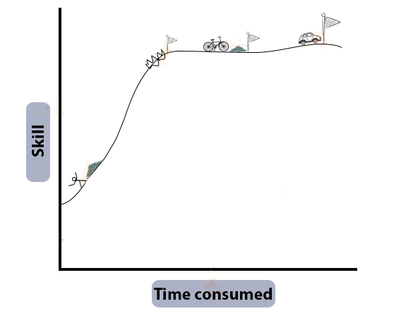

Slide 9
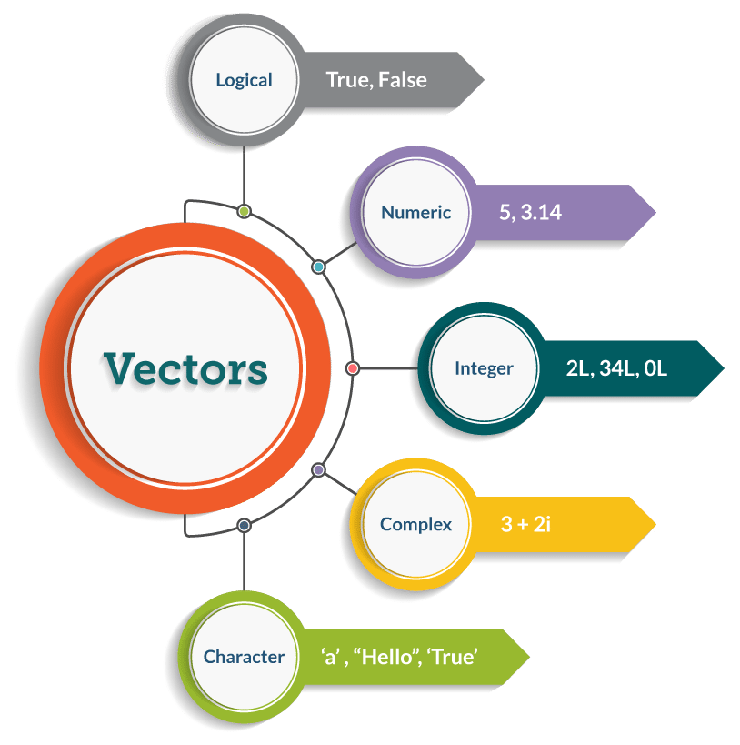
TRUE, FALSE

Slide 10
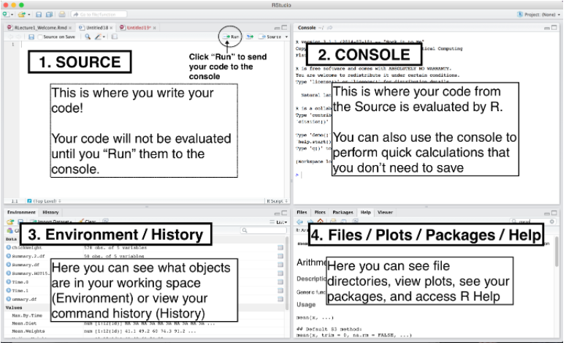

Slide 11
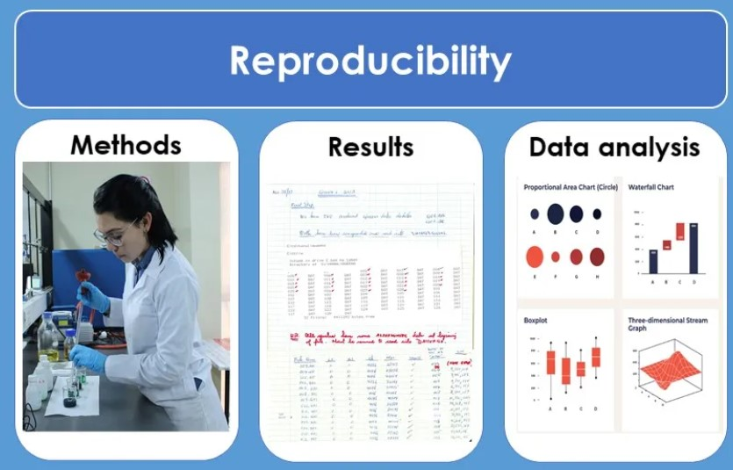
Reproducibility

